Slide 1
Beyond Churn Analysis:
Retail Customer Churn Prediction in a Leading American Wholesaler with Retailer’s Personalized Insights
“Your most unhappy customers are your greatest source of learning.” - Bill Gates
IE7275 Data Mining
Group 5 - Charu Aggarwal
Mei-Chun Hung, Sukanya Aswini Dutta, Vaibhavi Gaekwad, Wasinee Opal Sriapha, Yufei Wang
April 25, 2020

Slide 2

Recipient of the two highest awards for research achievements in the field of data-mining:
ACM SIGKDD Innovation Award (2019)
IEEE ICDM Research Contributions Award (2015)
Author of 8 books: Outlier Analysis for High-Dimensional data being one of the most popular ones
Published 400 papers
Over 80 patents (has applied for or been granted)
H-index: 102

Slide 3
Educational Background and Field of Interest
Massachusetts Institute of Technology
Ph. D. in Operations Research (1996)
Indian Institute of Technology, Kanpur
Bachelor of Technology in Computer Science and Engineering (May 1993)
Received various awards for academic excellence, academic proficiency, best finishing undergraduate
One of his favorite success stories is in the field of high dimensional data
Designed a suite of algorithms for such high-dimensional tasks
Clustering
similarity search
outlier detection

Slide 4
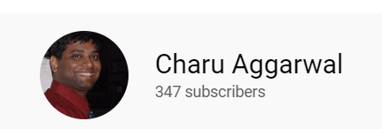
Notable Thoughts on Data Mining/ML
“Feature extraction, selection and representation are extremely important. It is all too often that we ignore these important aspects of the data mining process.”
“To extract information from data, the role of the domain expert can never be discounted. However, the common theme in all these cases is to create a more compressed, concise, and clean representation into one of the data types we all recognize and know how to process.”
His Youtube Channel contains some great learning videos on Neural Networks, Deep Learning and more

Slide 5
Predicting Membership Churn: What and Why?
The number of customers who leave a company during a given time period
Why?
It will cost a company much much more to bring a new customer up to the same level as that of an existing customer.
The second reason will lie in the fact that the more customers the business retains, the more revenue it makes!
Our Objective:
To predict the customers who are likely not to renew their memberships
To identify the most significant factors that might affect a customer’s renewal decision. The findings will introduce the retailer suggestive hints towards handling customer renewal

Slide 6

Data Description
Raw dataset:
22 columns
120,450 rows
Predictor variables:
Account Info
Member Personal Info
Shopping Info
Response variable:
Renew
The project is about studying human behaviors, the data has some limitations due to some factors outside of dataset, such as seasonal factor

Slide 7
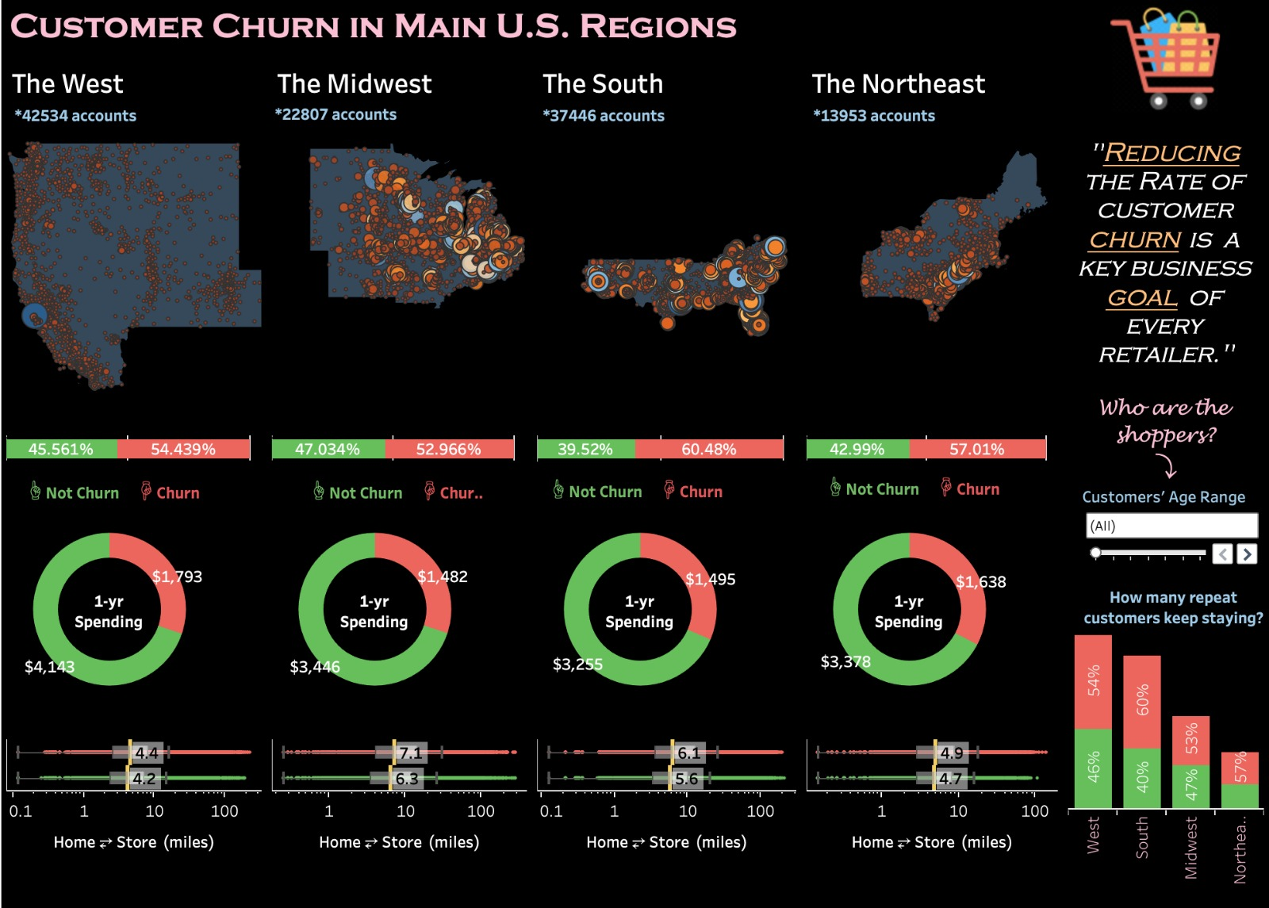
Data Visualization from Tableau
The age group increases the churn rate decreases.
Midwest has less churn compared to West but the western region has higher spending amounts.
The West region spends the most with average spending up to $4,143 with the least home to store median distance which is about 4.2 miles.
The most loyal customers are from the Midwest region and the maximum churn is found in the South region.

Slide 8
Association Rules
Set up bin numbers:
customer’s age
days since the customer last shopped
the distance between customer's address to the closest warehouse
total amount of purchase in one year
Used the Apriori Algorithm to uncover key behaviors of churn customers
Specified the minimum support criterion and confidence level
Generated the list of items that meet the support criterion

Slide 9

Association Rules
With the 0.0048 support level and 0.92 confidence level
RENEW = N
Have been at least one year member
Have not visited the store for over 300 days
Spent less than $1000 during the calendar year
With the 0.002 support level and 0.827 confidence level
Shop1Yr = 1001-5000
Renew membership
Non-executive type account
Midwest Region
2 cards in account
Age 30-34
Have not visited the store for less than 60 days
Less than 10 miles to the closest warehouse

Slide 10
Data Mining Tasks
Data Reduction
Checked missing/nulls
Dropped the irrelevant column (Customer ID)
Found correlations of variables & importance of variables
Data Transformation
Encoded response variable (RENEW) into factor 1 and factor 0
Reduced the number of categorical predictors levels
Created dummy variables to represent binary factors for categorical predictors

Slide 11
Data Mining Models
The dataset was partitioned rows of data randomly into training (70%) and validation (30%) sets
The training set was used to fit all models, while the validation set was held out to assess the models’ performance
Five main classifier models were developed to classify the customers into the churn and non-churn categories
The aim is to investigate those algorithms and to propose the best predictive model for the customer churn prediction in addition to identifying churning factors

Slide 12
Data Mining Models
Models | Why? | Why not the best?
Logistic Regression | Suitable for binary classification problem Easy to interpret the mathematical relationship | Assumption requires for independence of each predictor variable May be overconfident
Decision Tree | Clear tree structures supporting mixed dataset Clear feature importance output | Multiple control options need be set up
Random Forest | Overcome the overfitting issue of the individual decision tree Handle missing values and outliers efficiently | Accurate model requires for more trees, extending the testing time Hard to interpret the descriptive information of the dataset
KNN | Promising classification model for labeled and scaled input data | Requires better feature selection technique and domain knowledge
SVM | More effective on high dimensional space | Not suitable for large data set Complex to interpret the model

Slide 13
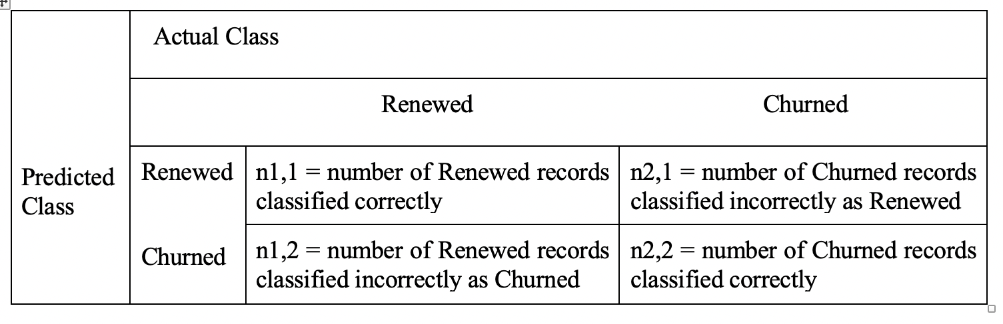
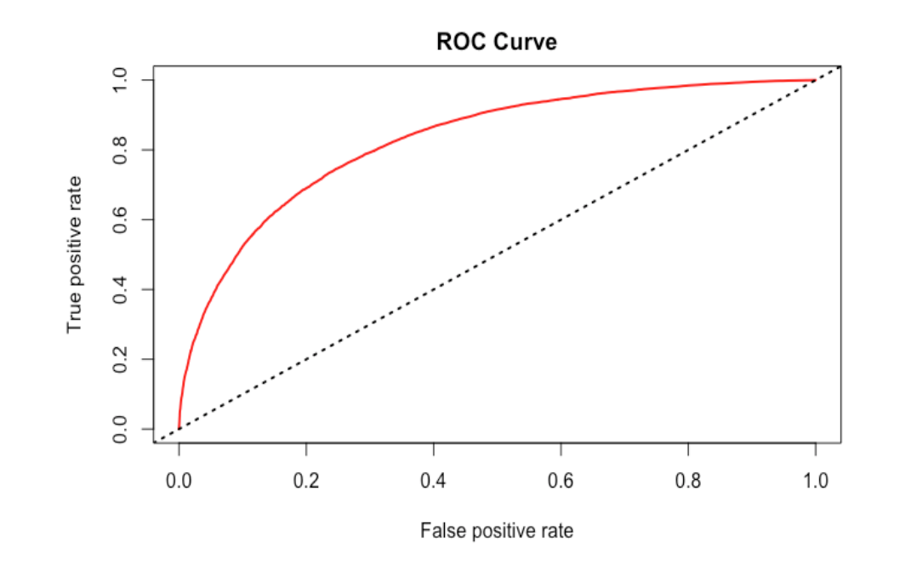
Performance Evaluation
Confusion Matrix
ROC (Receiver Operating Characteristic Curve)
Plots sensitivity and the specificity as the cutoff value descends from 1 to 0 AUC (Area Under the Curve): the higher the AUC value, the better the model performs
Accuracy (Rate of Correct Prediction) = (n1,1 + n2,2) / n
Sensitivity (Rate of Predicting Renew) = n1,1/(n1,1 + n1,2)
Specificity (Rate of Predicting Churn) = n2,2/(n2,1 + n2,2)

Slide 14
Performance Comparison
Model | Accuracy | AUC
Stepwise Logistic Regression | 70.85% | 0.78
Pruned Decision Tree | 70.26% | 0.73
Tuned Random Forest | 75.25% | 0.83
K Nearest Neighbor | 70.38% | 0.70
Support Vector Machine | 71.59% | 0.71
Stepwise Random Forest | 75.44% | 0.83

Slide 15
Conclusions
Predictive Model
The Random Forest classification with stepwise selection algorithm is highly recommended to generate a model with moderately high prediction accuracy (76%)
Data Exploration
The Tableau visualization dashboard and the Association Rules helped uncover the demographic and behavioral characteristics of the customers.
Will likely churn: customers who have not visited the store for over 300 days and spent less than $1000 during the calendar year
Most loyal customers were in Midwest (approximately 47% churned), the least in the South (approximately 60% churned)

Slide 16

Challenges & Limitations
Human behavior is not straightforward
Each individual is unique
Change in individuals’ behaviors
Lack of date/time variable

Slide 17
Future Work
Use transaction profiles of customers as additional data to the current dataset
Obtain the exact length/duration of each account
Acquire date/time variable
Attempt other advanced learning techniques
Explore the best frequency that the churn prediction should be made.
Conduct interviews with professionals in the retail/wholesale industry
As Charu mentioned, knowledge from the professionals would be great to obtain, to gain more insights in the retail/wholesale industry more domain knowledge can enhance the feature selection process of the learning model construction

Slide 18

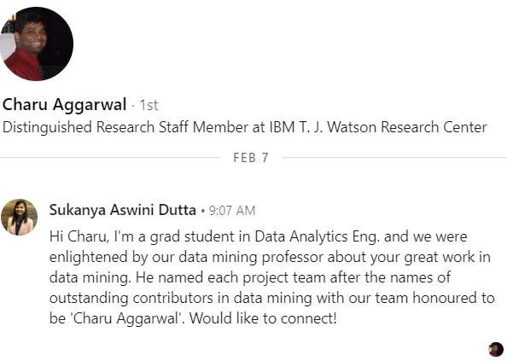
Thank You
Great Job, kids!
Any Questions?

Slide 19
Reference
BBVAOPEN4U. (2020). Big Data[Photograph]. Retrieved from https://bbvaopen4u.com/en/actualidad/four-interesting-ideas-harness-big-data
Edunonix. (2018). Data Mining[image]. Retrieved from https://blog.eduonix.com/internet-of-things/top-5-popular-data-mining-techniques/
Francis, A. (2019). Shutterstock[image]. Retrieved from https://www.channelfutures.com/mssp-insider/top-5-challenges-in-providing-managed-security
Microsoft PowerBI Team. (2018). Association Rules[image]. Retrieved from https://community.powerbi.com/t5/R-Script-Showcase/Association-Rules/td-p/58491
Poulson, B. (2016) Data Mining[Video image]. Retrieved from https://www.lynda.com/Business-Intelligence-tutorials/Data-Science-Foundations-Data-Mining/475936-2.html
Santora, J. (2019). [image]. Retrieved from https://optinmonster.com/google-analytics-101-how-to-track-your-conversions-step-by-step/
Weiss, M. (2019). Churn[image]. Retrieved from https://www.clientengagementacademy.com/blog/the-five-step-guide-to-build-a-membership-site-to-prevent-member-churn/

